Slide 1
Photo-Realistic background generation
Ganiyu Ibraheem & Philipp Seybold
Advanced Computer Vision
Group A3
Ganiyu Ibraheem Philipp Seybold
COMP6206 Advanced Computer Vision
<number>
Notes:
<number>

Slide 2
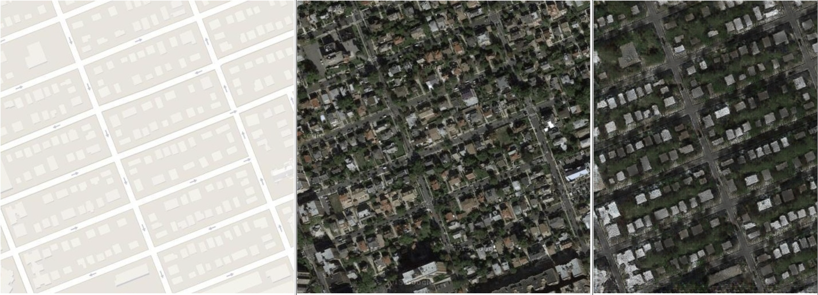
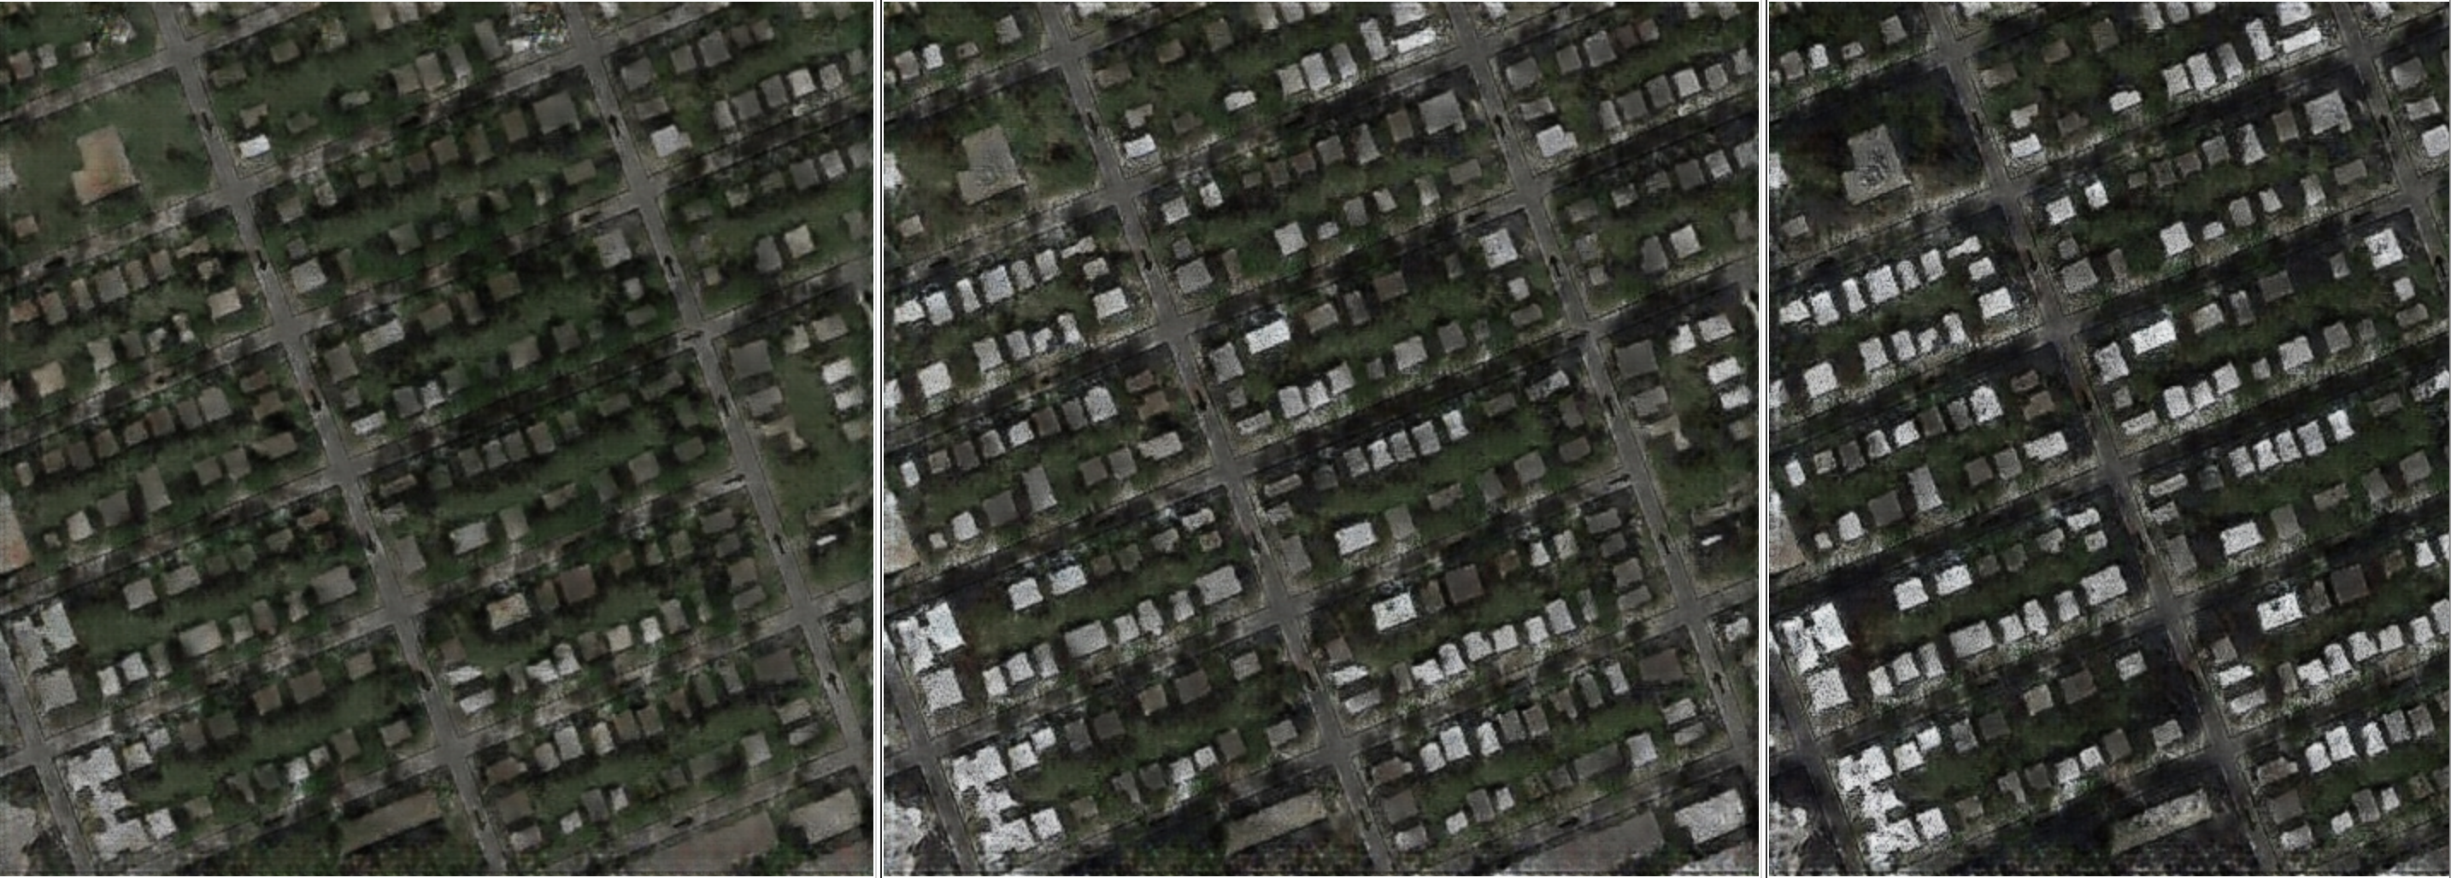
Multi-Modal Image to Image Translation
Ganiyu Ibraheem Philipp Seybold
COMP6206 Advanced Computer Vision
<number>

Slide 3
Overview
Introduction
Ganiyu Ibraheem Philipp Seybold
COMP6206 Advanced Computer Vision
<number>
Notes:
<number>

Slide 4
Introduction
Generative Adversarial networks (GANS) have found profound use
in image generation
Ganiyu Ibraheem Philipp Seybold
COMP6206 Advanced Computer Vision
<number>
Notes:
<number>

Slide 5
Problem?
Many of these use-cases have only been successful in generating single
Images.
We take this a step further by being able to generate a distribution of
images

Slide 6
Related work
Ganiyu Ibraheem Philipp Seybold
COMP6206 Advanced Computer Vision
<number>

Slide 7
Multimodal image-to-image translation
Ganiyu Ibraheem Philipp Seybold
COMP6206 Advanced Computer Vision
<number>

Slide 8
Implementation Details
Ganiyu Ibraheem Philipp Seybold
COMP6206 Advanced Computer Vision
<number>

Slide 9
Sources
[1] | J.Y. Zhu, R. Zhang, D. Pathak, T. Darrell, A. A. Efros, O. Wang, E. Shechtman. Toward Multimodal Image-to-Image Translation. In NIPS, 2017
[2]
[3]
[4]
[5]
Ganiyu Ibraheem Philipp Seybold
COMP6206 Advanced Computer Vision
<number>
Notes:
<number>

Slide 10
Work distribution
Ganiyu Ibraheem Philipp Seybold
COMP6206 Advanced Computer Vision
<number>
Notes:
<number>

Slide 11
TODO

Slide 12

Discussion
Any Questions?
Ganiyu Ibraheem Philipp Seybold
COMP6206 Advanced Computer Vision
<number>

